Slide 1




ReSIDUAl VALUE PREDICTION FOR LEASED VEHICLES

Slide 2


PROBLEM STATEMENT:
Build a predictive AI model that estimates the residual value of leased vehicles at the end of their lease term. The model should consider factors like mileage, vehicle condition, market trends, and historical data to provide accurate predictions.
EXPECTED SOLUTION:
A tool for leasing companies to accurately predict residual values, improving lease terms and reducing losses at the end of lease cycles.

Slide 3

TEAM VIBRANT
Fatima Khurram
Muntaha liaqat
Muhammad Farooq
Email: khurramfatima201@gmail.com
Email: muntahaliaqat981@gmail.com
Email: khurramfatima201@gmail.com
University: National College of Business Administration and Economics
University: National College of Business Administration and Economics
University: National College of Business Administration and Economics

Slide 4
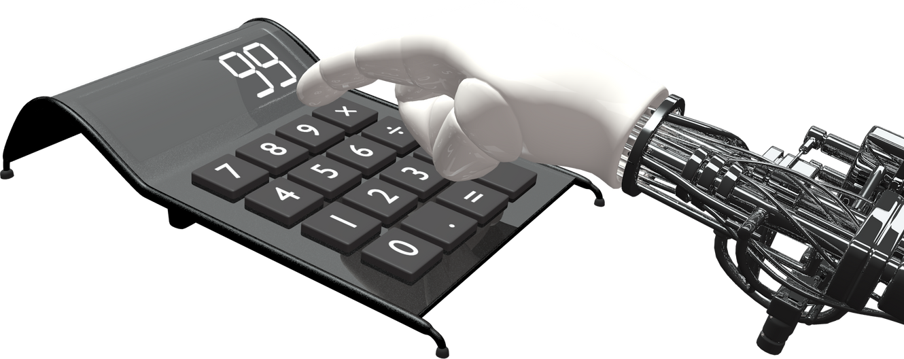
VISION OF THIS SOFTWARE:
"To empower leasing companies with a cutting-edge, AI-driven predictive tool that accurately estimates the residual value of vehicles, enabling smarter decision-making, minimizing financial risk, and driving operational efficiency. Our software aims to revolutionize the leasing industry by integrating advanced machine learning algorithms with real-world market trends, vehicle conditions, and historical data, providing an intuitive and scalable solution that adapts to evolving market needs and customer expectations."
AI-driven tool to accurately predict vehicle residual values.
Minimize financial risks and optimize lease terms.
Integrate market trends, vehicle conditions, and historical data.
Revolutionize the leasing industry with smarter decision-making.
Enhance operational efficiency for leasing companies.

Slide 5

SOLUTION APPROACH :
1
2
3
4
Data Collection & Preprocessing
The first step involves collecting data from various sources, including vehicle-specific data (such as mileage, age, and condition), market trends (like depreciation rates and resale values), and historical lease data. Once the data is gathered, it undergoes preprocessing, where it is cleaned, normalized, and structured to ensure accuracy and consistency in the prediction model.
Model Development
In this stage, machine learning algorithms are applied to the preprocessed data. Linear Regression is used to capture basic relationships between factors like mileage and residual value. More advanced models, such as Random Forest and Neural Networks, are implemented to capture complex patterns and interactions between variables. The goal is to develop a robust model that predicts the residual value with high accuracy.
Prediction & Evaluation
The developed models are then tested using real-world data. Evaluation metrics like Mean Absolute Error (MAE) and R-squared are used to assess the performance and accuracy of the predictions. Continuous refinement is done through techniques such as cross-validation to ensure the model generalizes well across various scenarios and data points.
Deployment & User Interface
Once the model is optimized, it is deployed as a cloud-based solution. A user-friendly interface is created, allowing leasing companies to input relevant vehicle data (e.g., mileage, condition) and receive instant residual value predictions. This interface is designed to be intuitive and accessible, offering real-time insights and actionable predictions for improving lease terms and risk management.

Slide 6
OBJECTIVES
OBJECTIVE
GOAL
KEY PERFORMANCE INDICATOR
Develop a predictive model to estimate the residual value of vehicles more accurately.
To provide a tool for leasing companies to improve lease terms, avoid overestimations, and minimize end-of-lease financial losses.
Reduce prediction error rate and enhance forecast accuracy.

Slide 7
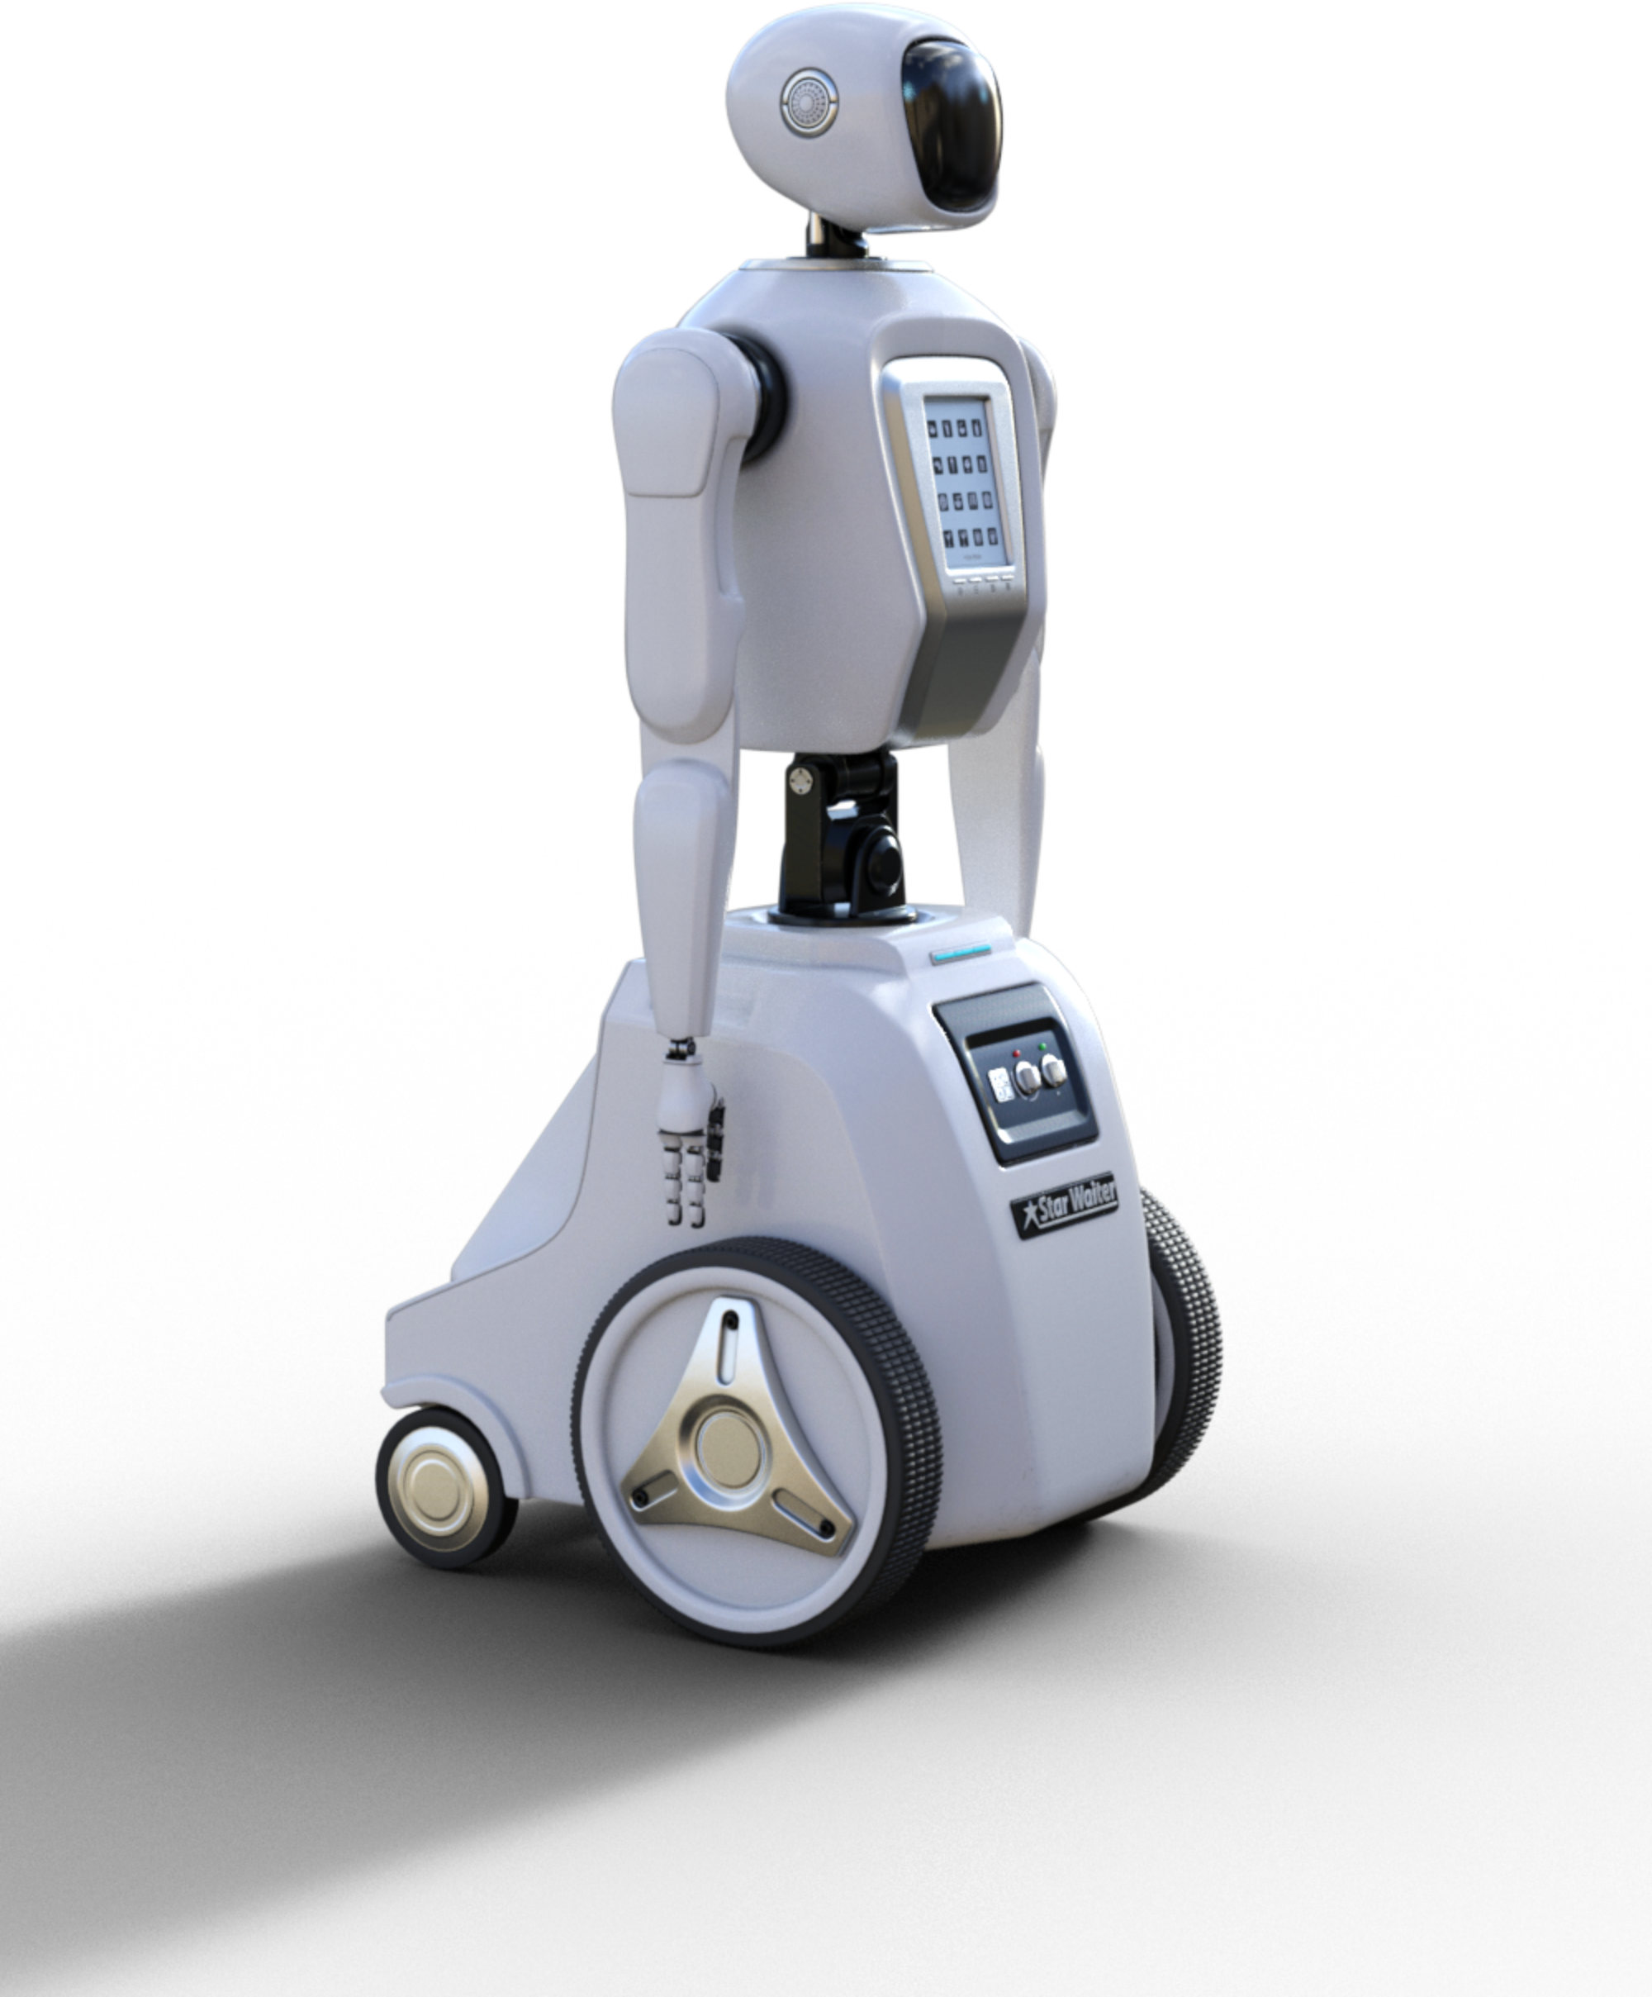
PROJECT SCOPE
ANALYSIS OF KEY VEHICLE AND MARKET DATA AFFECTING RESIDUAL VALUE.
APPLICATION OF MACHINE LEARNING ALGORITHMS FOR PREDICTION.
DEVELOPMENT OF A USER-FRIENDLY INTERFACE FOR LEASING COMPANIES.

Slide 8

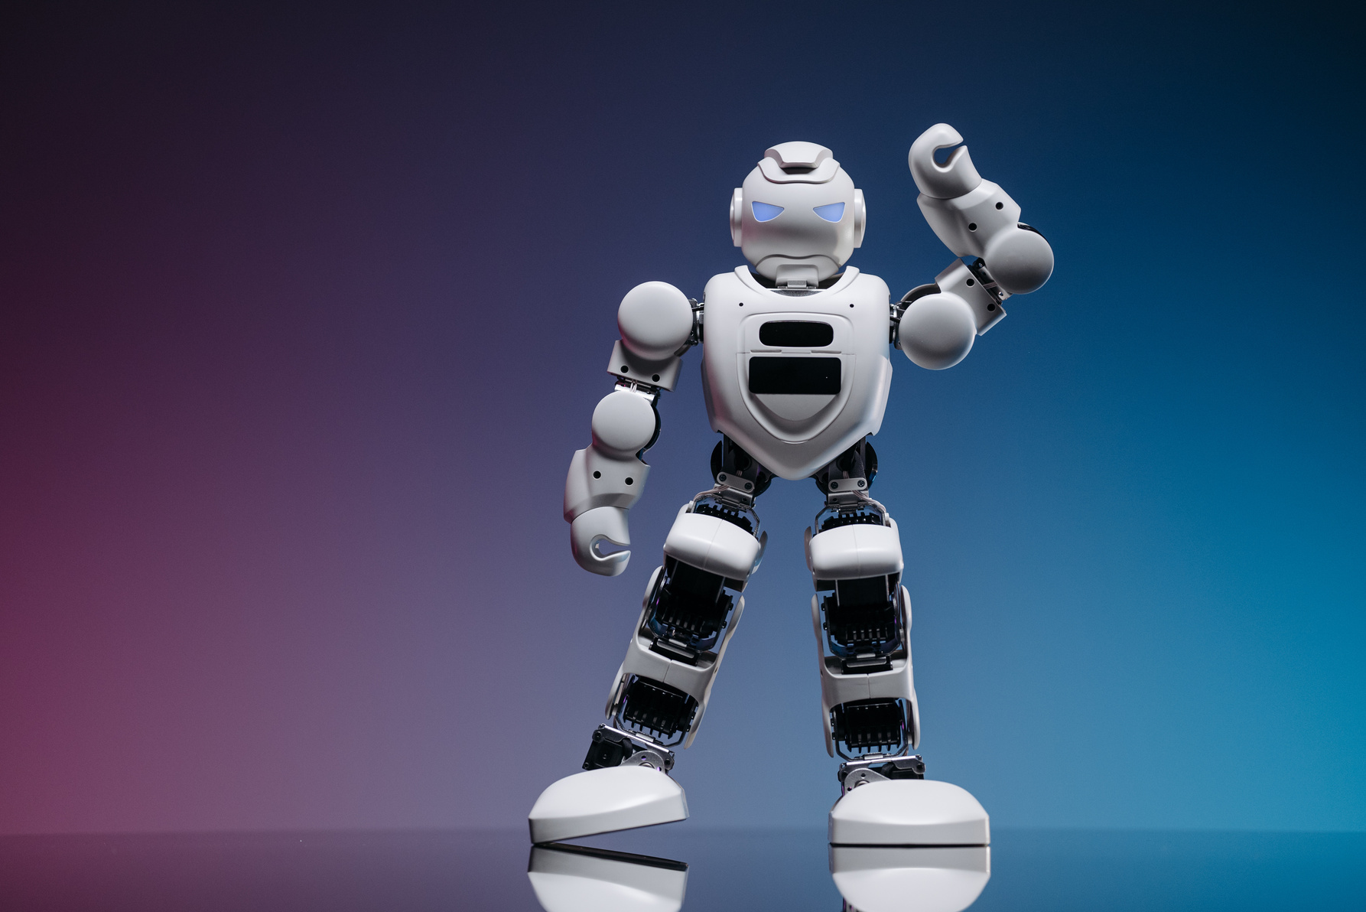
TECHNICAL ARCHITECTURE
DATA PIPELINE:
Data collection
Feature extraction
Prediction output.
Data cleaning
Model training

Slide 9
TECHNICAL ARCHITECTURE
MODEL WORKFLOW:
Data Preprocessing (Handling missing values, normalization).
Training with regression models and machine learning algorithms.
Testing and validation of model accuracy.

Slide 10

TECH STACK USED :
REACT
NODE.JS
DJANGO
TENSORFLOW
PANDAS
MONGODB
NUMPY

Slide 11
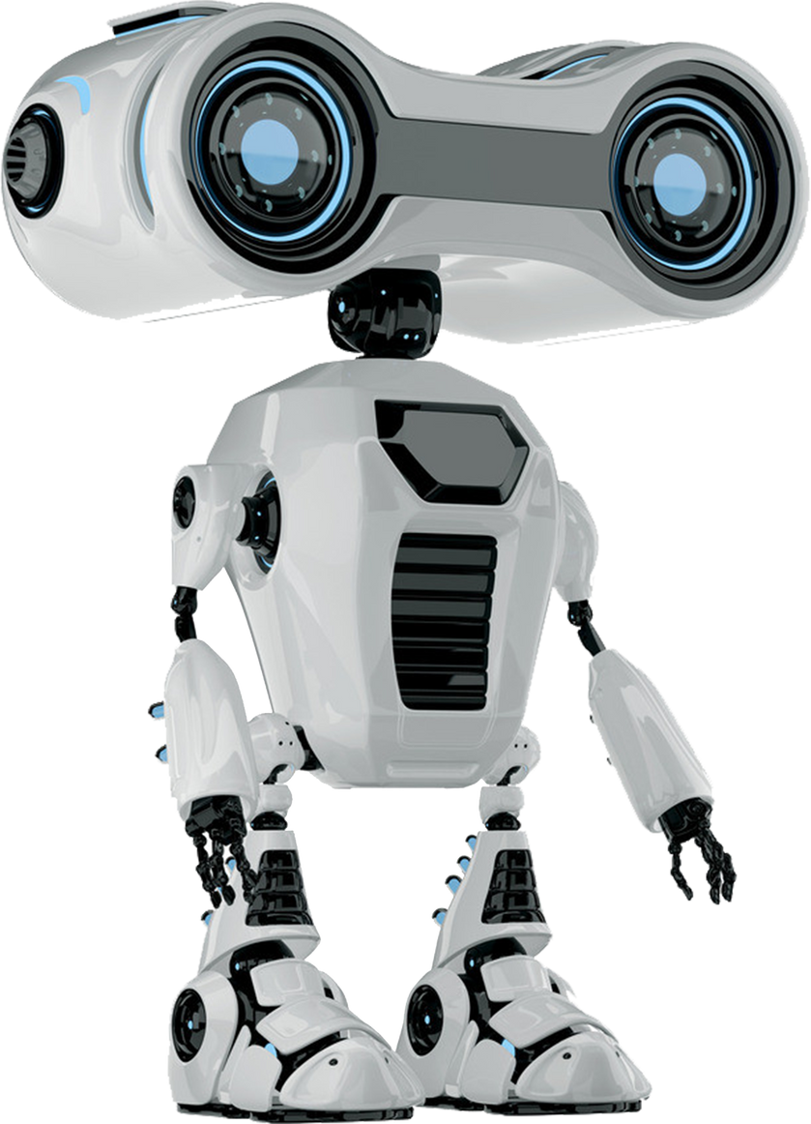
THANK YOU

